Slide 1

Scripture Engagement

Slide 2



?
At church
How will the community engage with Scripture?
In Sunday school or small groups
In homes / with children

Slide 3

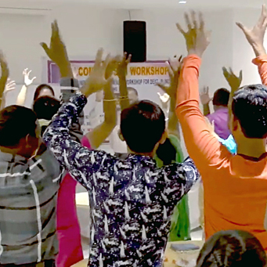
Community Change Through Scripture
More believers
Increased hope and expectation
Increased church attendance
Sinful behaviors decrease
More baptisms

Slide 4

Help the Community Use Scripture
Application guide:
Scripture questions that apply to every-day life

Slide 5
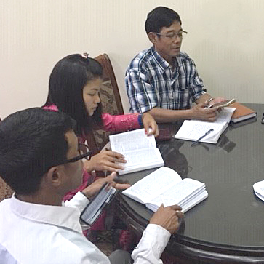
Gauge and Celebrate Change
Biblical outcomes questionnaire:
Survey to assess change from Scripture use

Slide 6

Include Others in Scripture Usage
Read Acts 8:27-38
Apply this to plans for Scripture in community

Slide 7


